Slide 1

Seat Booking System
Space Optimization Dashboard
Developed By: Sharvani • Technology Stack: React, Express.js, MongoDB

Slide 2

Problem Statement
Current capacity
Utilization goal
50 physical seats for 80 employees split into two batches — demand exceeds supply.
Maximize seat utilization while preserving fairness and operational flexibility.
Operational constraints
10 floater (buffer) seats available; dynamic seat release and time-based booking rules required.

Slide 3

System Overview
Real-time Dashboard
Batch 1
Live seat state & availability
Week A schedule
Alternating Weeks
Seating & Scheduling Flow
Batch 2
Week B schedule
Batches rotate weekly
Floater Pool
Designated Seats
Shared available seats
Assigned to employees
Two batches rotate on alternating weeks. Each employee has either a designated seat or accesses floater seats. A real-time dashboard provides visibility into seat state and availability.

Slide 4
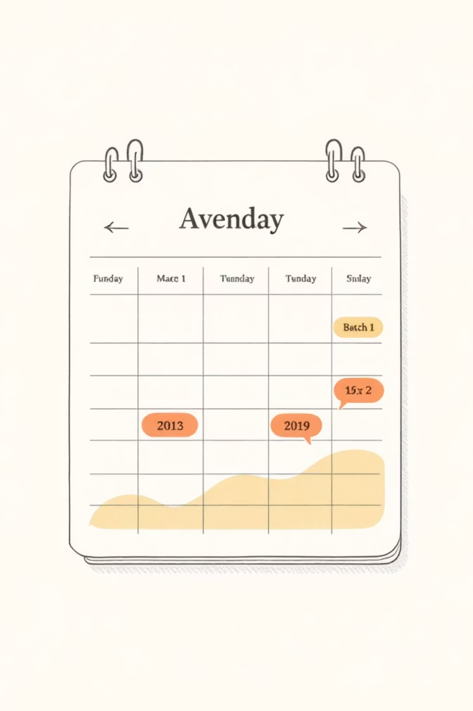
Batch Scheduling Logic
01
02
Rotation pattern
Detailed schedule
Week parity determines who is on-site: batches alternate across Week 1 and Week 2.
Batch 1: Mon–Wed (Week 1), Thu–Fri (Week 2). Batch 2 follows the reverse pattern.
03
Calculation & enforcement
Week parity logic computed in backend. Business rules enforced server-side to prevent client-side drift.

Slide 5


Booking Rules
All bookings validated against eligibility, time rules, and existing reservations before persistence.
Designated Seats
Floater Seats
Book anytime for up to 2 weeks. Users may release seats; entitlement persists per-assignment.
Reserved for employees not scheduled to work that day. Bookings allowed only for the next day and only after 3 PM. One floater seat per employee per day.

Slide 6
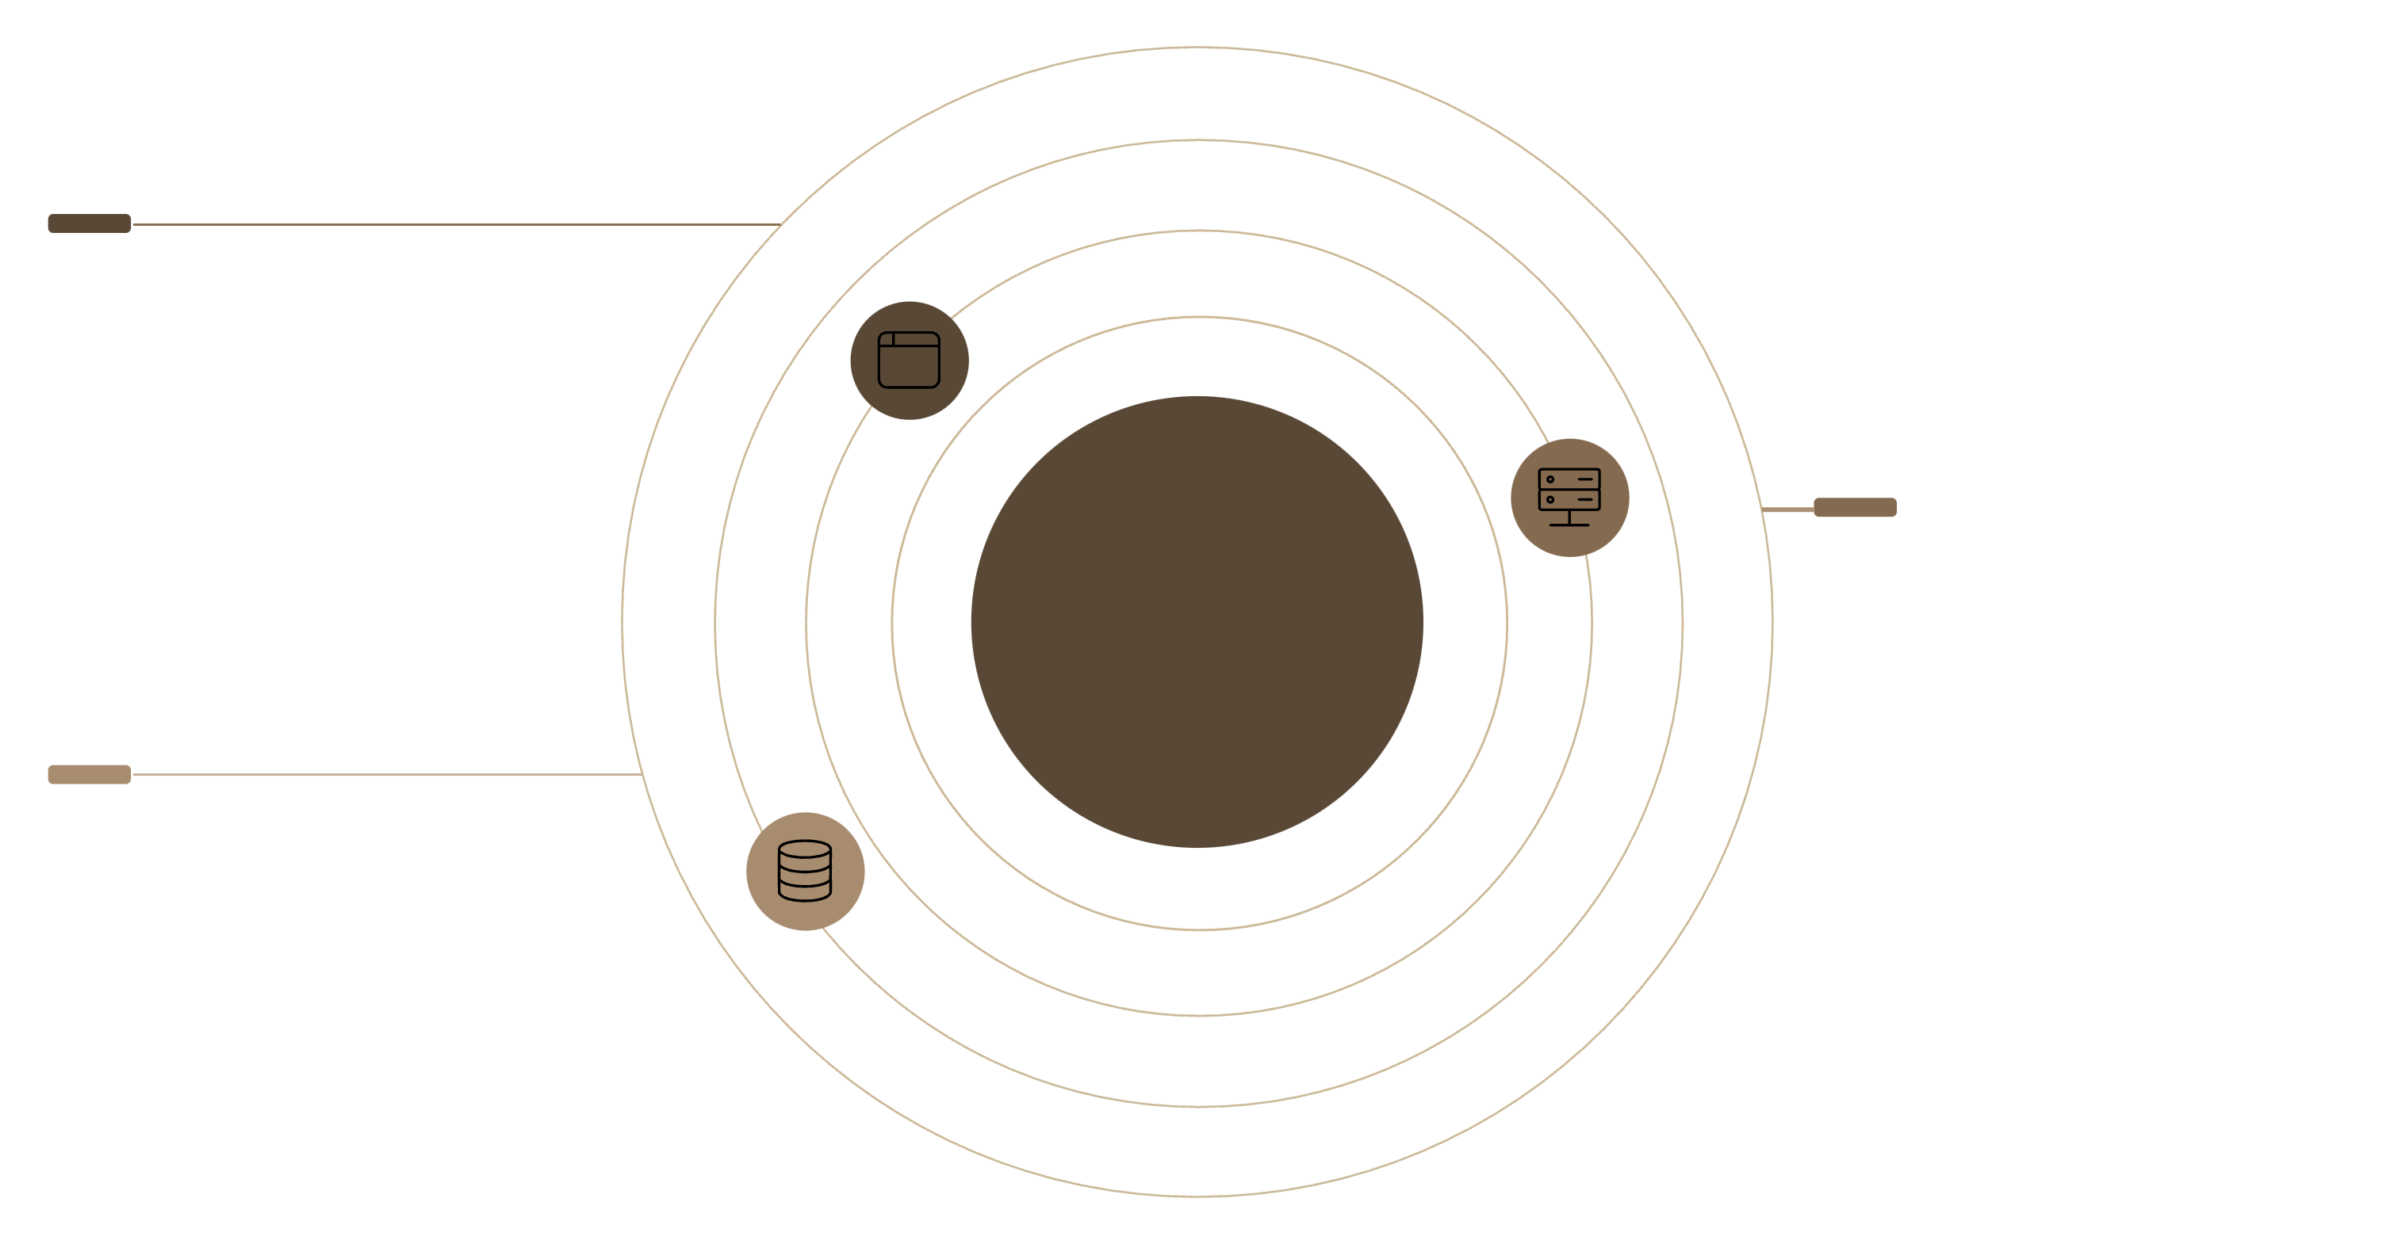

System Architecture
Frontend (React)
Dashboard UI and booking controls
Three-Tier Architecture
Backend (Express.js)
API layer enforcing business rules
Database (MongoDB)
Stores users, seats, and bookings
Frontend provides Dashboard UI and booking controls. Backend enforces business rules, computes week parity, and exposes APIs. MongoDB stores users, seats, and bookings. Optional WebSocket channel pushes real-time seat state changes to clients.

Slide 7

Database Design
Relationships: Users ↔ Bookings (one-to-many); Seats ↔ Bookings (one-to-many). Use indexes on date, seatId, and userId for fast conflict checks.
Users
Seats
Bookings
Employee profiles, batch assignment, work schedule, permissions.
Seat metadata: seatId, type (designated/floater), location, assignedUser (optional).
Transactional records: userId, seatId, date(s), bookingType, status, createdAt.

Slide 8
Core Business Logic
Seat release & validation
Floater calculation
Week parity logic
Computes available floater seats per day after honoring designated assignments and existing bookings.
Release triggers vacancy logic and notifies waiting list; all bookings run through pre-checks to prevent conflicts.
isWorkingDay()
Calculates Week 1 vs Week 2 from ISO week number to assign batch rotations.
Determines whether a date is a working day, accounting for weekends and holidays.

Slide 9

Dashboard UI
Seat Grid
Interactive grid with one tile per seat — click to book or release.
Color Coding
Green = Available, Red = Booked, Yellow = Floater, Blue = Released. Color palette aligns with theme: #D3C5B6, #F2EBDF, #DECEBB.
Controls
Date filter, batch toggle, Booking & Release buttons, and real-time notifications for changes.

Slide 10
Key Challenges & Solutions
Week rotation complexity
Duplicate bookings
Solution: Centralized parity computation in backend with unit tests and fallback rules for timezone edge cases.
Solution: Atomic booking transactions with unique compound indexes (seatId + date) and optimistic locking.
Dynamic floater seats
Time-based restrictions
Solution: Daily recalculation job after designated seat assignments close, with a prioritized waiting list.
Solution: Enforce “after 3 PM” booking window server-side and surface clear UI prompts for users.

